Slide 1

Oscar organization
NXT15_CAI2_ERP2_G2
(payroll team)

Slide 2

Payroll team
1- Marwan Sayed
2- Maiada El Ganzory
3- Mai Hesham
4- Abdallah Salah

Slide 3

About the Company
Company Name: Oscar Organization
Industry: Fintech (Financial Services)
Mission: Delivering scalability, compliance, employee engagement, security, and intelligent insights
Solution: Oracle E-Business Suite (HCM)

Slide 4
Challenges that the HR Management faces
1. Specialized Talent Acquisition:
- Oracle HCM Solution: Oracle Recruiting Cloud.
2. Regulatory Compliance and Risk Management:
- Oracle HCM Solution: Oracle Workforce Compliance and Labor Relations .
3.Remote and Hybrid Workforce Management:
- Oracle HCM Solution: Personalized workflows and self-service capabilities.
4. High Turnover and Employee Retention:
- Oracle HCM Solution: Oracle Compensation Management

Slide 5
Challenges that the HR Management faces
5. Managing diverse HR policies, pay structures, and benefits across countries:
- Oracle HCM Solution: Oracle Global HR
6. Handling sensitive data and are prime targets for cyberattacks, including HR data breaches:
- Oracle HCM Solution: Enterprise-grade security with encryption, access controls & audit
7. Data-Driven HR Decision-Making:
- Oracle HCM Solution: Oracle HCM Analytics

Slide 6
Organizational Chart
CEO
COO
CFO
CTO
CRGO
CHRO
VP of Customer Services
Director of Financial Planning & Analysis
Director of Investor Relations
Director of Accounting
VP of Software Engineer
VP of Infrastructure
VP of Cyber Security
Director of Regulatory Compliance
Director of Risk Management
Director of Internal Audit
Director of Talent Acquisition
Director of Learning &Development
Director of Compensation &Benefits
CMO
Director of Branding
Director of Digital Marketing
VP of Operations
Director of Communication

Slide 7
Content
1- Setup for Oscar organization
2- Creating Work structure
3- Creating payroll

Slide 8
1- Setup
1- creating user
2- creating responsibility
3- linking responsibility with user
4- creating value sets (Job, Position, Grade, Competence, People group, Cost allocation)
5- Create values

Slide 9
1- setup
The importance of the setup relies on the following:
Access Control: Secure data access through user setup and responsibility assignment
Data Standardization: Consistent data entry through value sets
Data Integrity: Validation and standardization ensure accurate data
Flexibility: Easy maintenance and updates of valid values
Compliance: Support regulatory requirements through secure and controlled environment
Accurate Reporting: Standardized values enable reliable reporting and analysis
This setup supports Oscar Organization's financial operations by promoting data integrity, standardization, and accurate reporting. Also creating a secured and controlled environment for the organization

Slide 10
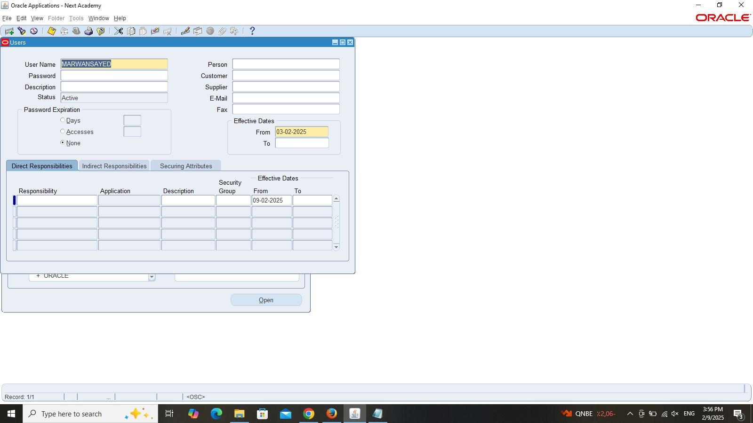
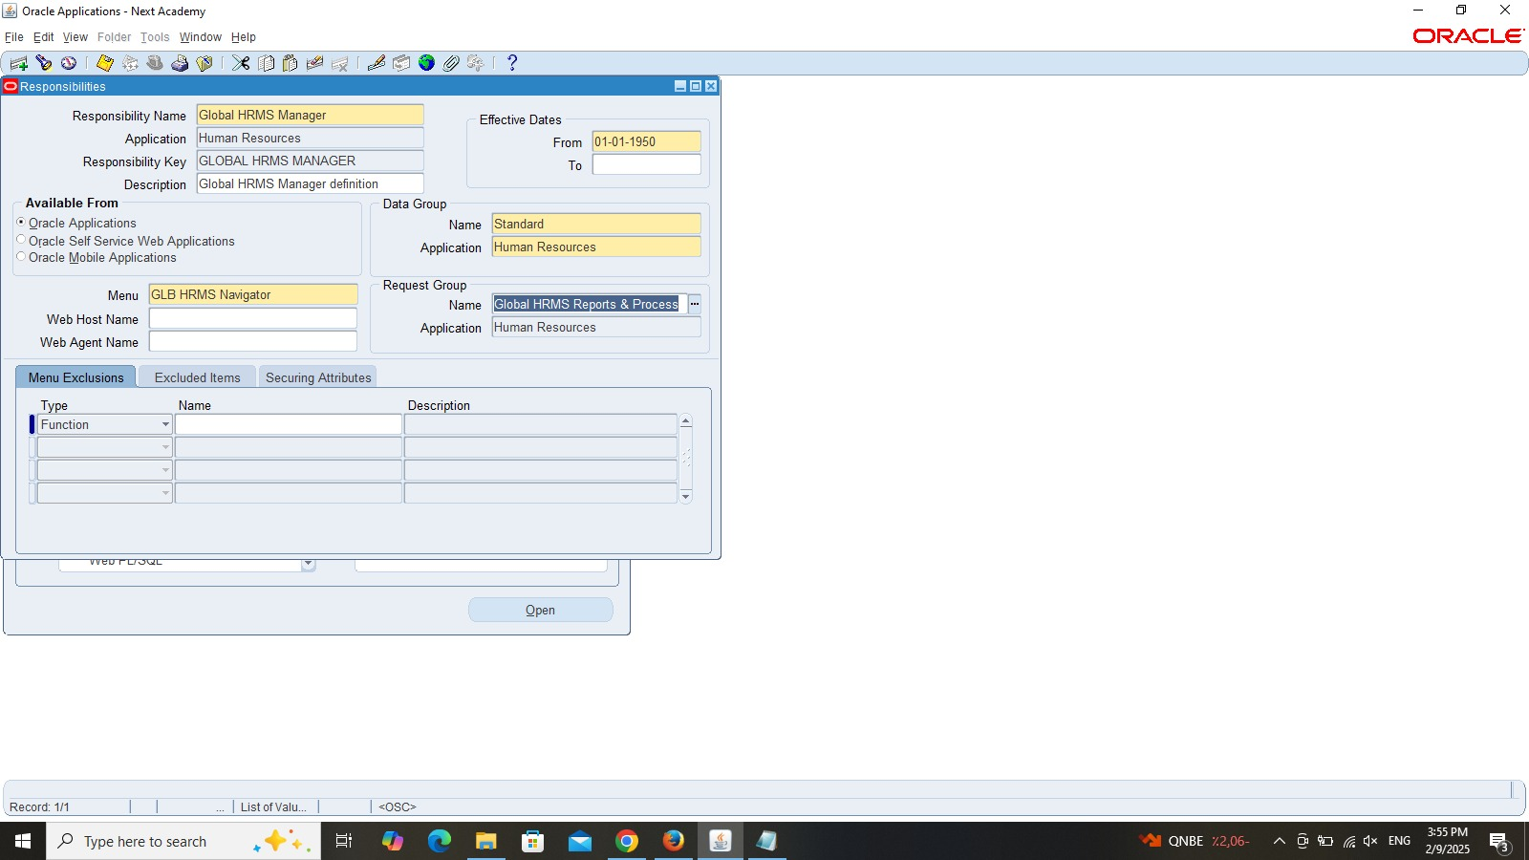
1- setup 1.1 creating user
Path>Security>user>define
(System administrator responsibility)
1.2 creating responsibility
Path>security>responsibility>define
(System administrator responsibility)

Slide 11
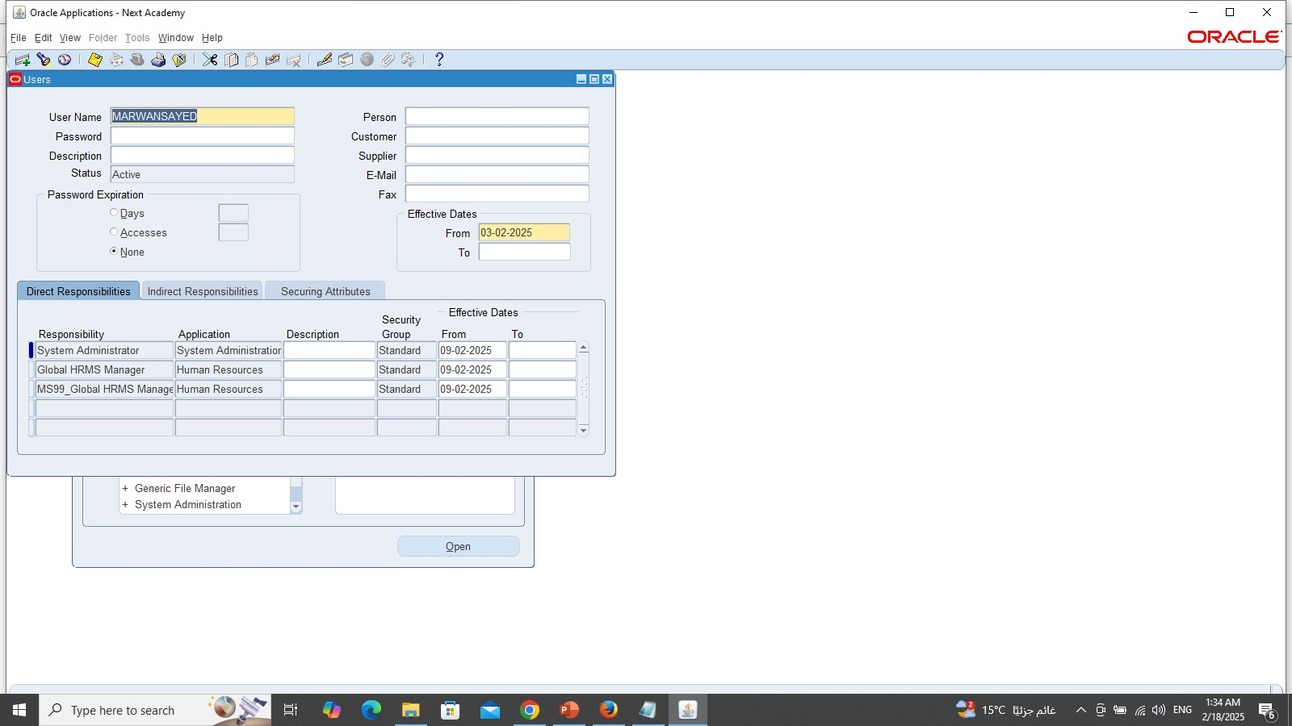
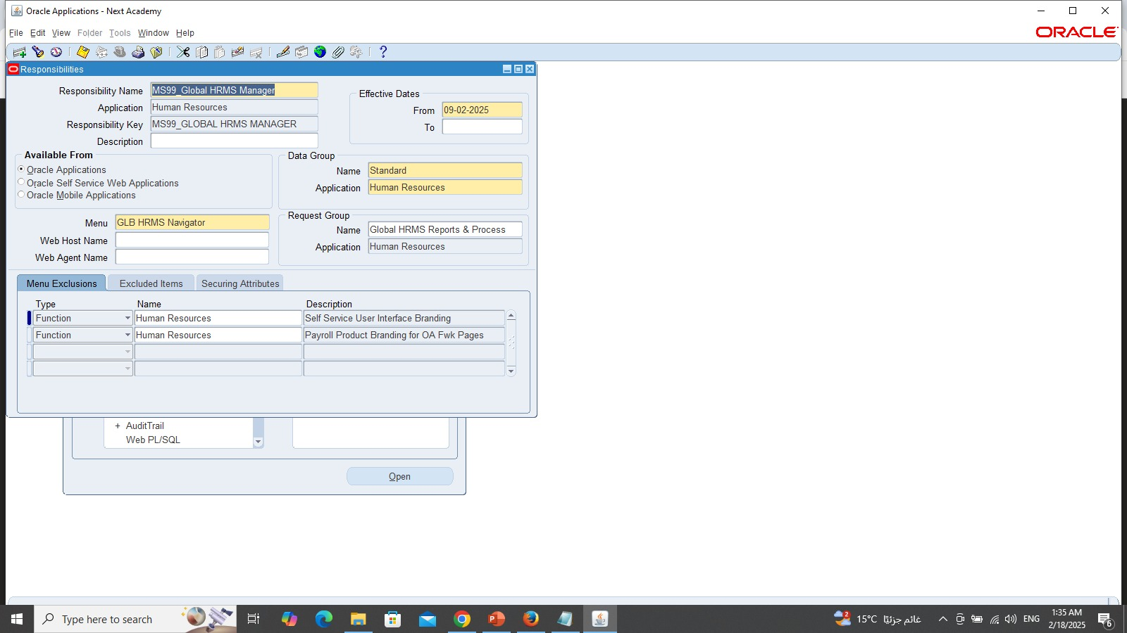
1- setup 1.3 linking responsibility with user
Creating responsibility (MS99_Global HRMS Manager) and linking it with the user (Marwan Sayed)
We can insert Global HRMS manager just incase if there is any error shows up

Slide 12
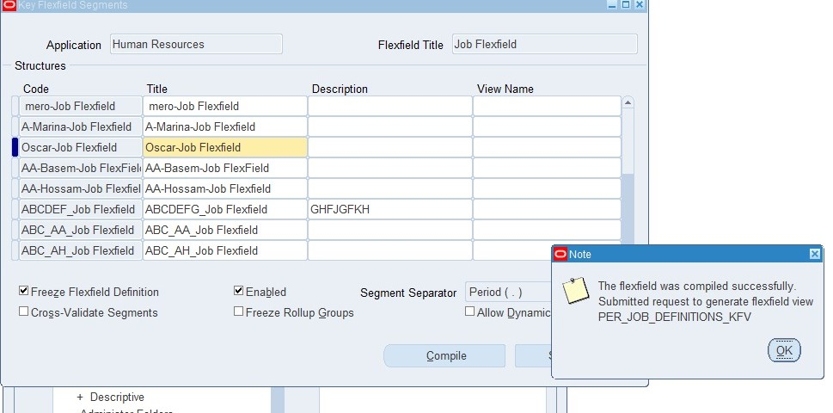
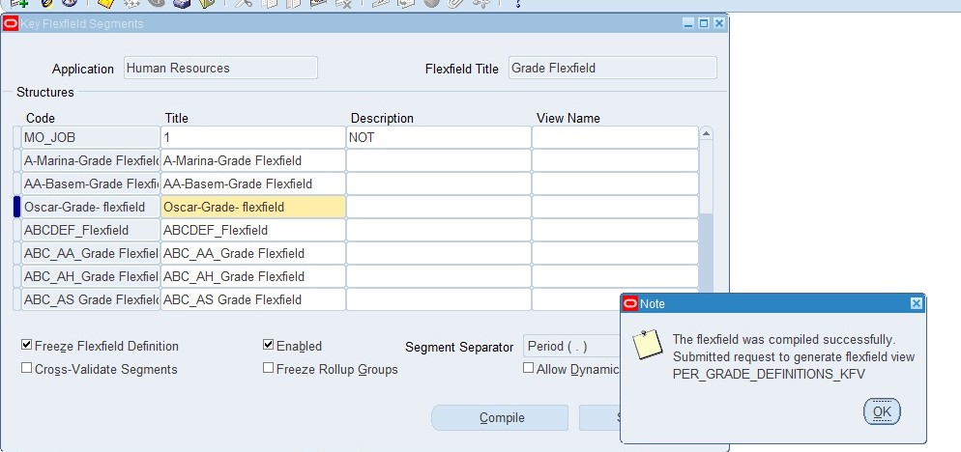
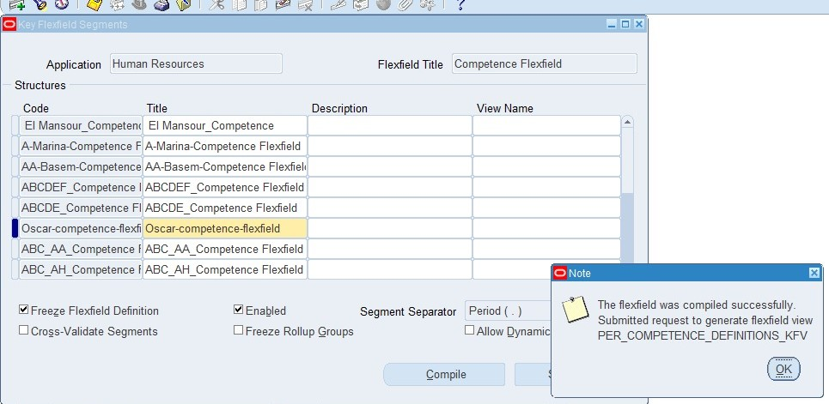
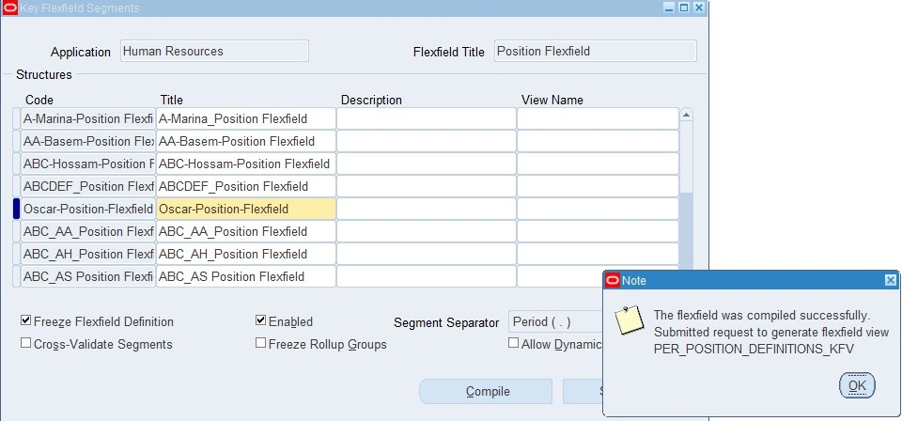
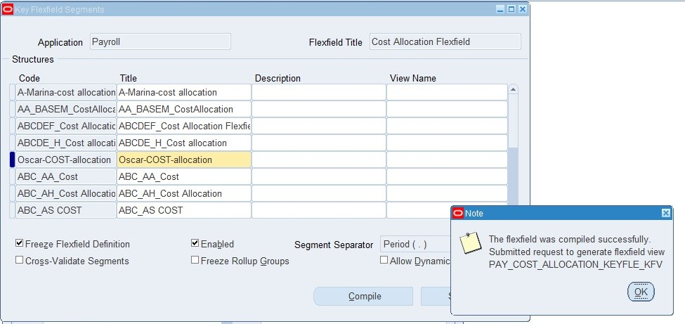
1-setup 1.4 Creating value sets
Creating Value sets and its values
Path>Application>flex field>key>segments
Notice: after creation of the flex field, you need to compile and click on enable insert and freeze to avoid troubleshooting

Slide 13
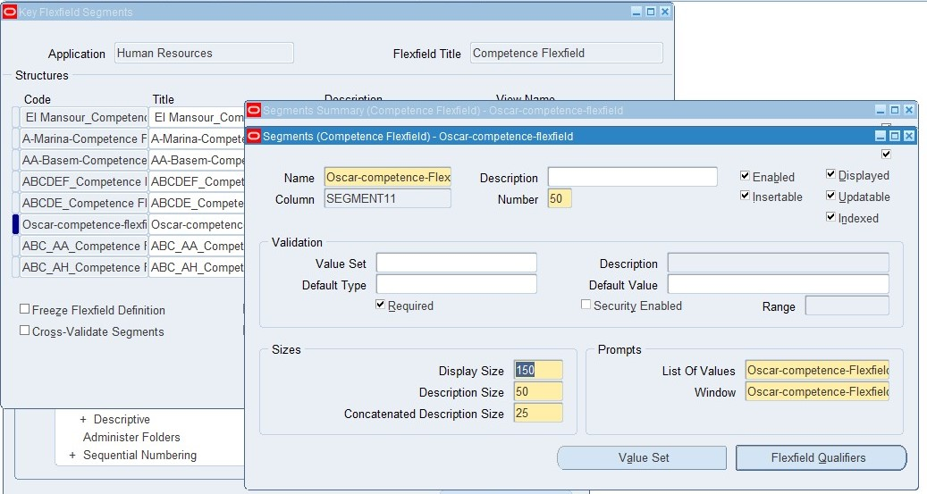
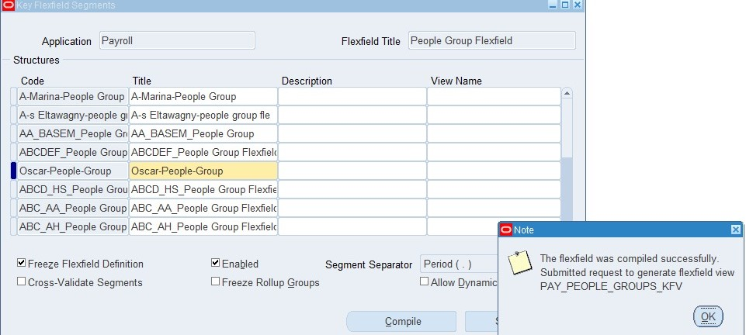
1- Setup 1.4 Creating value sets
Creating Value sets and its values
Path>Application>flex field>key>segments
Notice: after creation of the flex field, you need to compile and click on enable insert and freeze to avoid troubleshooting in order to allow coding while inserting information in work structure phase

Slide 14
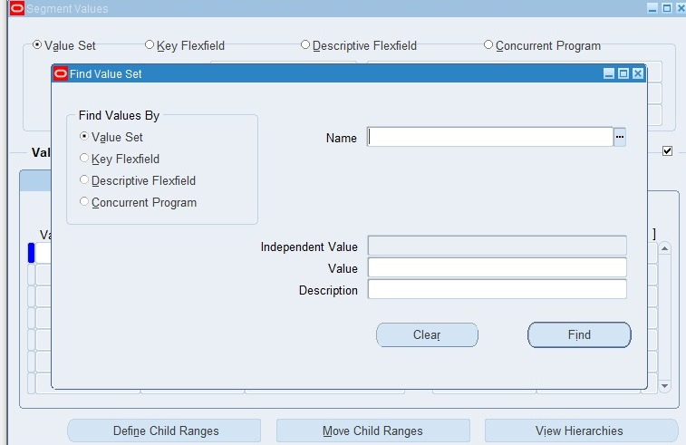
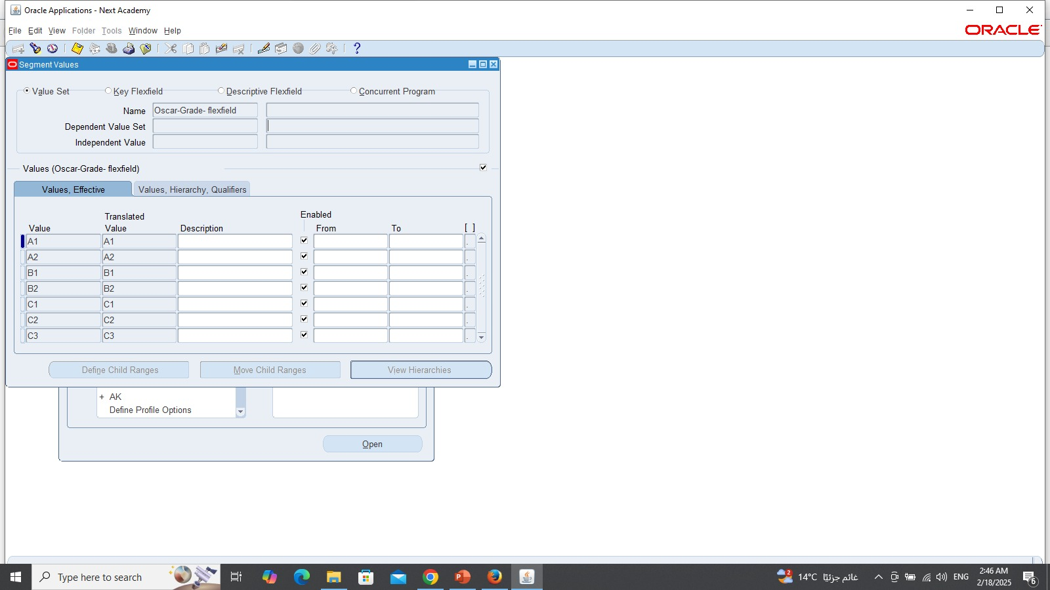
1- Setup 1.5 Creating values
Path>Application>validation>Values
(System administrator responsibility)

Slide 15
2- Work structure
1- Create Organization (Oscar organization) and linking it with responsibility
2- Create Position
3- Create grade and Job
4- Create User

Slide 16
2- Work structure
The importance of work structure relies on the following:
Accurate HR Data: Ensures precise employee information
Effective Workforce Planning: Supports strategic HR decisions
Improved Employee Management: Enhances employee onboarding, development, and evaluation
Compliance: Supports regulatory requirements
Streamlined Processes: Automates HR workflows and approvals
Data-Driven Insights: Enables informed decision-making
By implementing a well-structured work structure for the organization, we can Enhances HR efficiency, supports strategic planning, and ensures compliance.

Slide 17
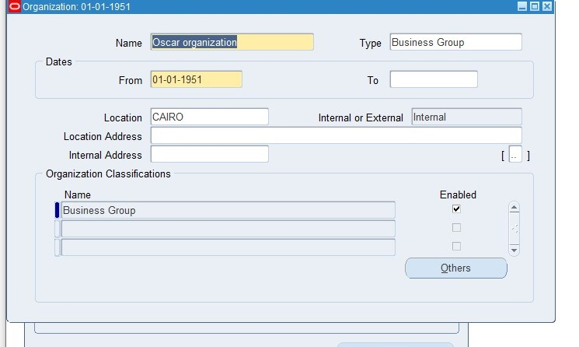
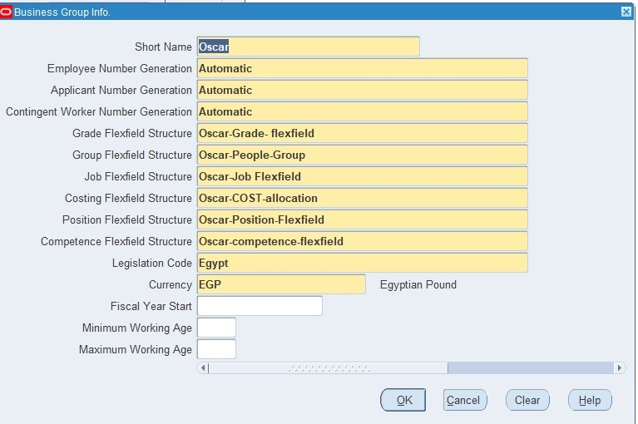
2- Work structure 2.1 create organization
Path> Work structure>organization> Description
(MS99_Responsibility)

Slide 18
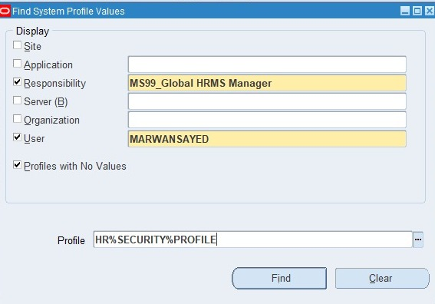
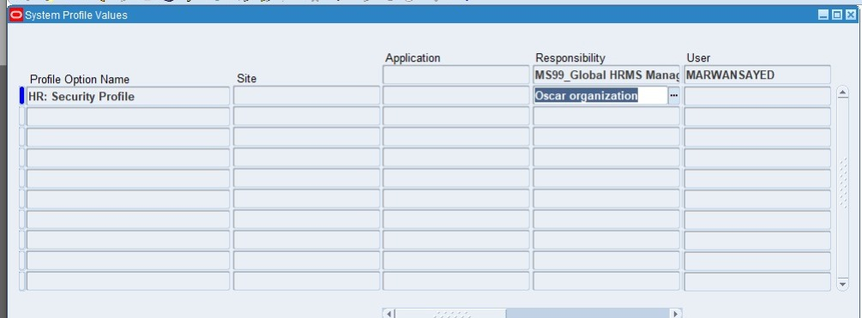
2-Work structure 2.1 create organization
Path>Profile>System
(Responsibility (system administrator)

Slide 19
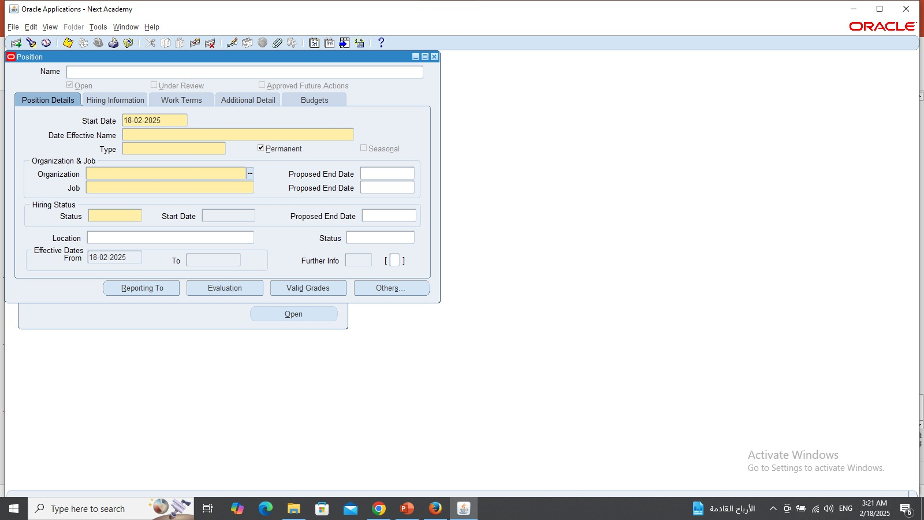
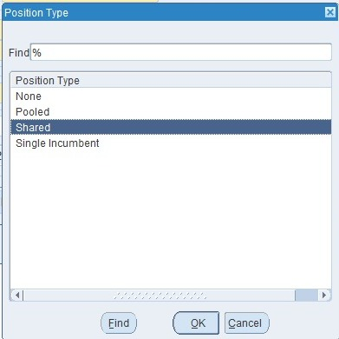
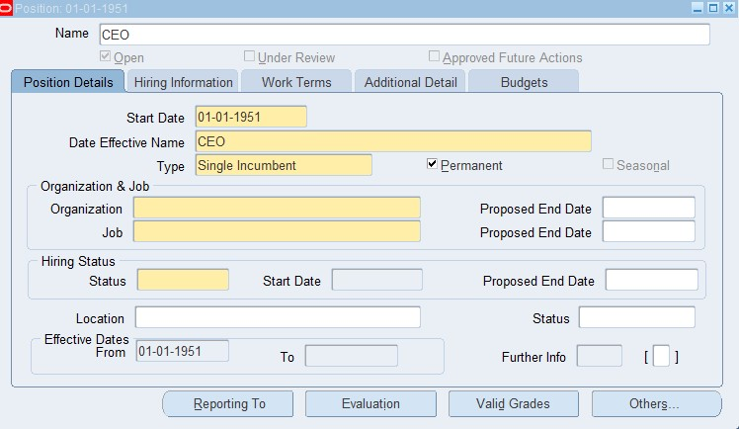
2-Work structure 2.2 create position
Path>Work structure>Position>Description
(MS99_Responsibility)

Slide 20
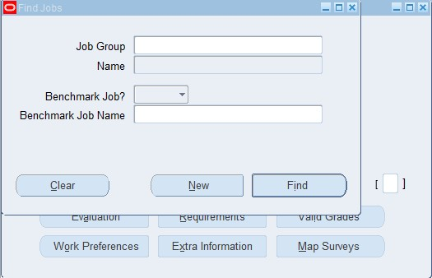
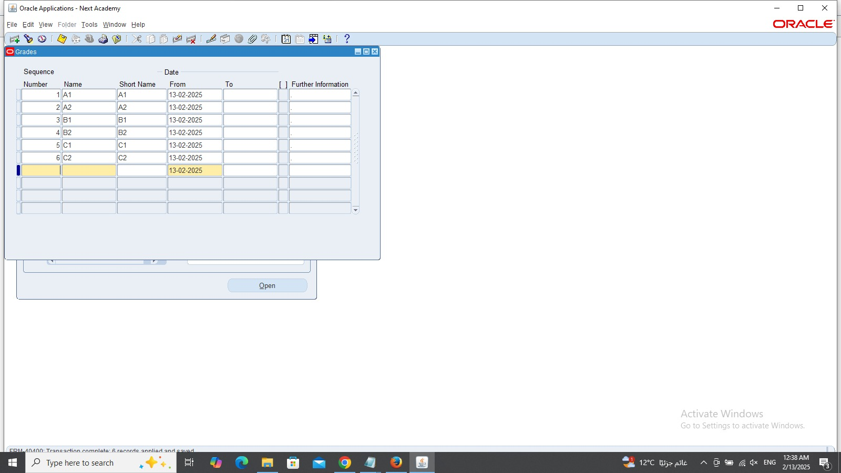
2-Work structure 2.3 create grade and job
Path>Work structure>Job>description
Path>Work structure> Grade>description
(MS99_Responsibility)

Slide 21
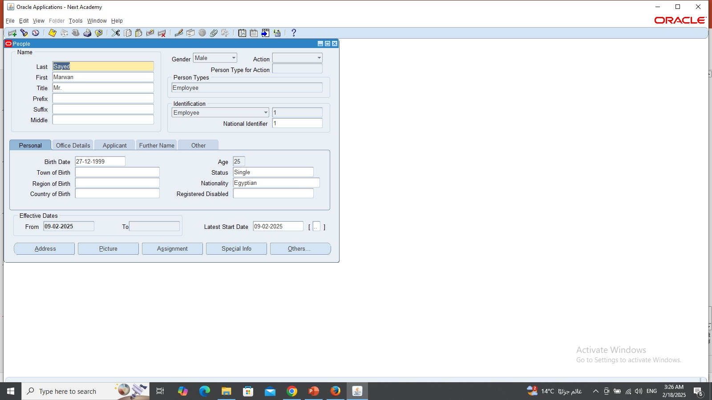
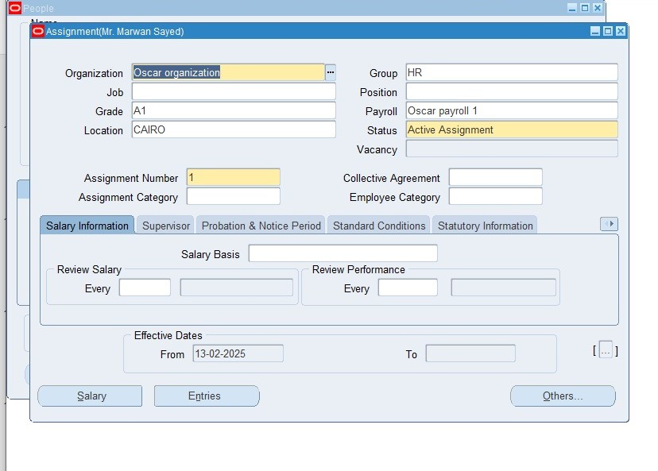
2- Work structure 2.4 create user
Path>people> enter and maintain
(MS99_Responsibility)
Then click on assignment to apply all setups

Slide 22
3- Payroll
1- Create consolidation
2- Create payroll (payment methods and payment types)
3- Create Elements
4- Link elements with payroll
5- Salary basis
6- Quick pay

Slide 23
3- Payroll
The importance of the payroll relies on the following:
Accurate Salary Calculations: Automates complex calculations and ensures precision.
Compliance with Regulations: Ensures adherence to tax laws, labor laws, and other regulations.
Streamlined Payroll Processes: Reduces manual errors and increases efficiency.
Integration with HR: Seamlessly integrates with HR data for accurate payroll processing.
Data Security: Protects sensitive employee data.
By implementing a robust payroll system, Oscar Organization can improve efficiency, reduce errors, and ensure compliance, ultimately supporting its overall success.

Slide 24
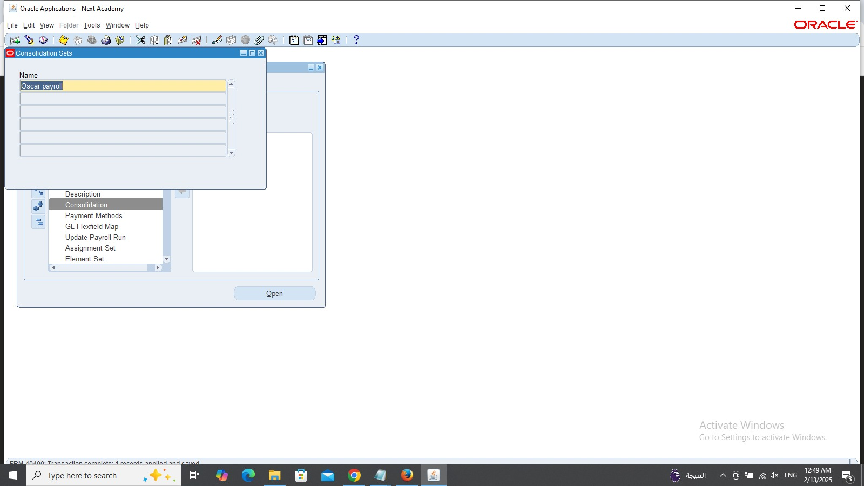
3- Payroll 3.1 create consolidation
Path>payroll>consolidation
(Responsibility MS99_)

Slide 25
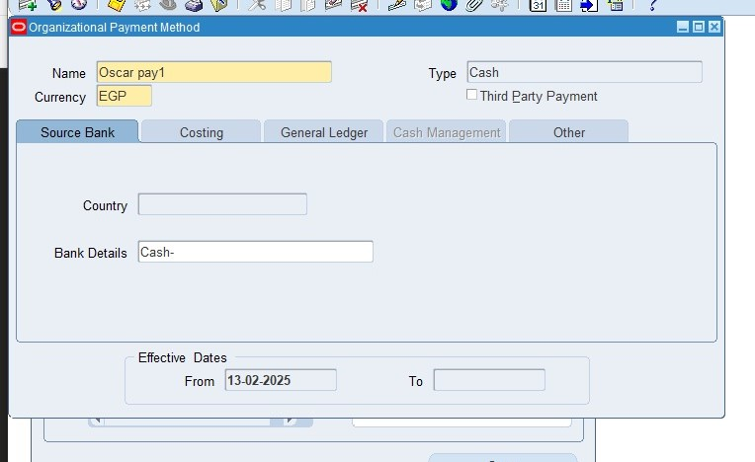
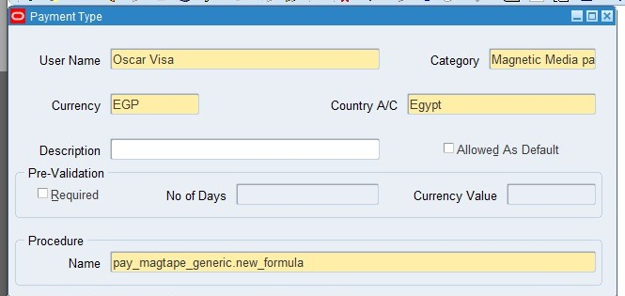
3- Payroll 3.2 create payroll
Path>payroll>payment method
(Responsibility MS99_)
Path>Payroll>payment types
(Responsibility MS99_)

Slide 26
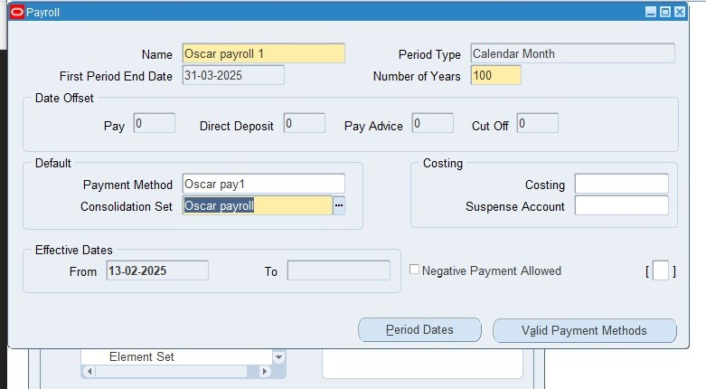
3- Payroll 3.2 create payroll
Path>Payroll>description
(Responsibility MS99_)

Slide 27
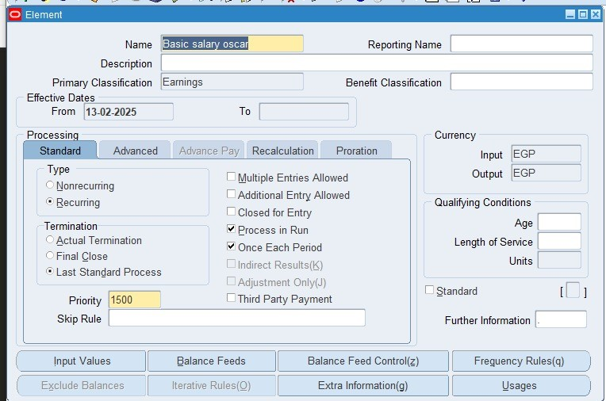
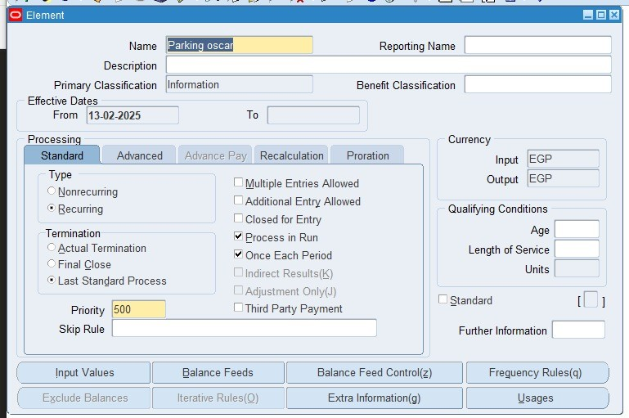
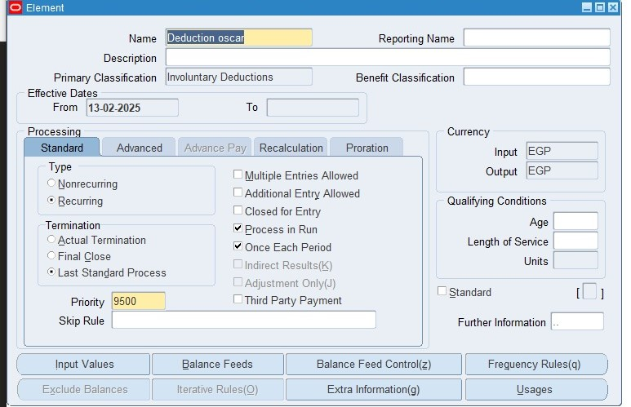
3- Payroll 3.3 create element
Path>Total compensation>basic>element description
We made three types of elements
(Earnings, deduction and information)
(Responsibility MS99_)

Slide 28
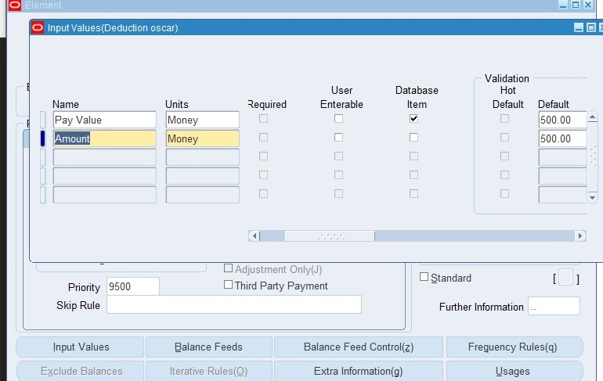
3-Payroll 3.3 create element
After that don’t forget to press on input value at the same window which you can make the user to insert the amount through his window and if you want to disable it make sure to clear the marker from (user enterable) and you can insert the amount that the owner wants in the default

Slide 29
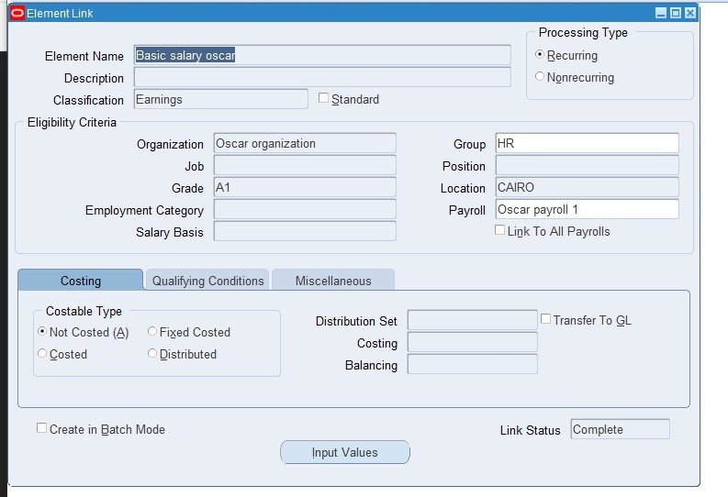
3- Payroll 3.4 Link elements with payroll
Path>total compensation>basic>link
(Responsibility MS99_)

Slide 30
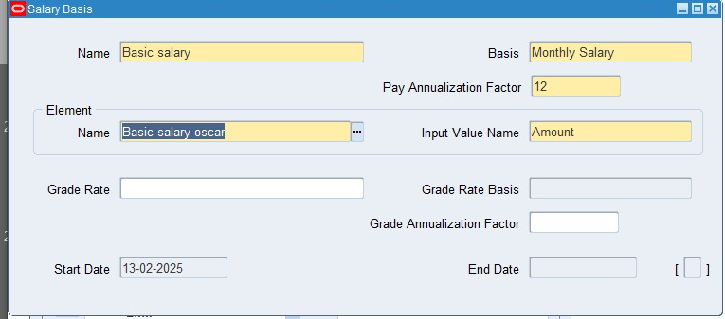
3- Payroll 3.5 salary basis
Path>Total compensation >> Basic>>Salary basis

Slide 31
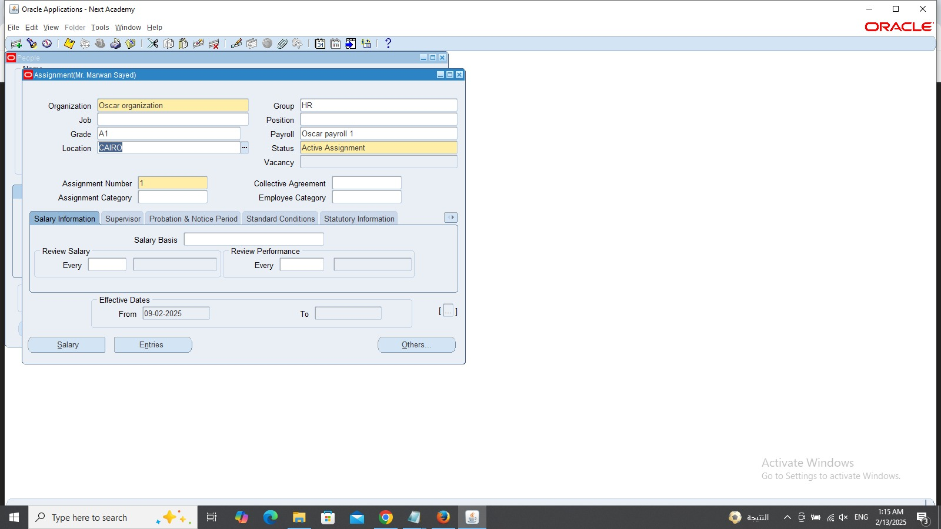
3- Payroll 3.6 quick pay
Path>people>enter and maintain>assignment
(Responsibility MS99_)

Slide 32
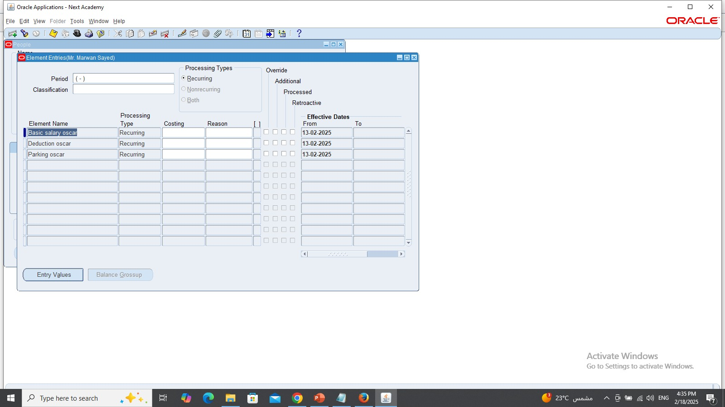
3-Payroll 3.6 quick pay
Path>people>enter and maintain>assignment>entries
(Responsibility MS99_)

Slide 33
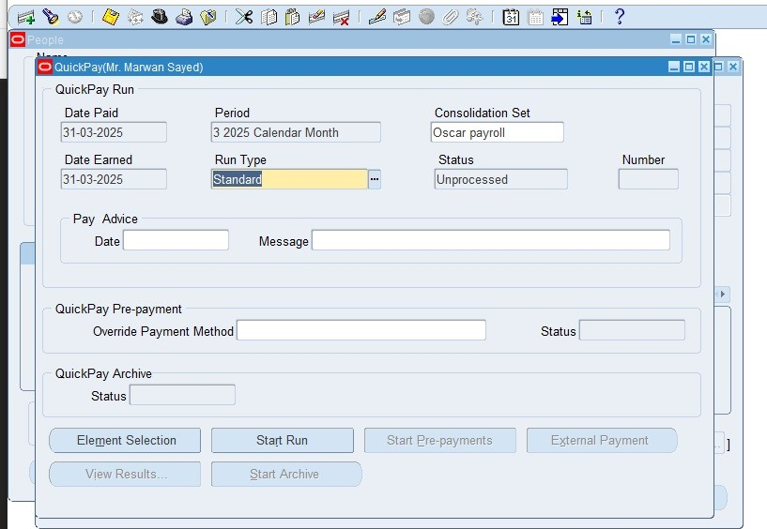
3- Payroll 3.6 quick pay
Path>people>enter and maintain>assignment>others> Quick pay then we press at start run and after that we will click on
View>request at the top we will see that the request already done as a tutorial for payroll system
(Responsibility MS99_)

Slide 34
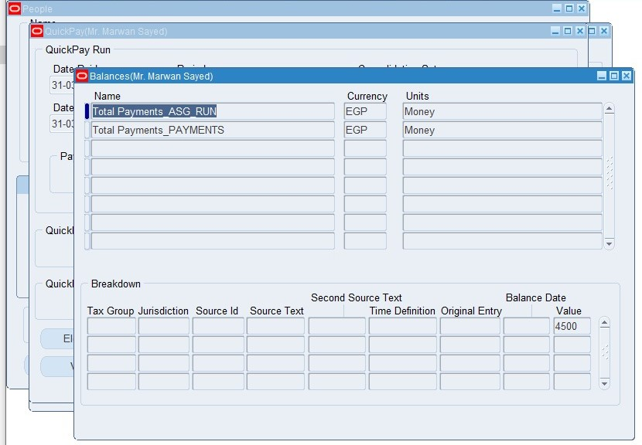
3-Payroll 3.6 quick pay
To view the result, we can see that it from the following path
Path>people>enter and maintain>assignment>others> Quick pay>view results>balances> standard balances window and we can see the value of amount is 4500 EGP
(Responsibility MS99_)

Slide 35
Any questions??

Slide 36
Special thanks to
Dr. Nader Elhabashy for his guidness and his efforts for teaching us

Slide 37

Thank you

